Slide 1


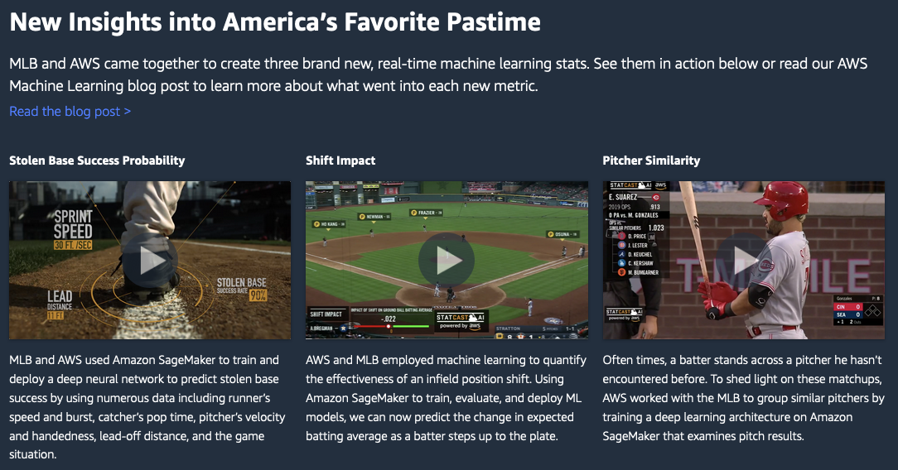
A collaboration and education program that connects Amazon machine learning experts with AWS customers and partners

Slide 2

AWS supports the Deepfake Detection Challenge with competition data and AWS credits
https://aws.amazon.com/blogs/machine-learning/aws-supports-the-deepfake-detection-challenge-with-competition-data-and-aws-credits/

Slide 3

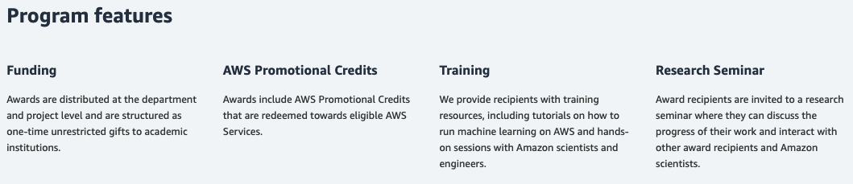
https://aws.amazon.com/aws-ml-research-awards/

Slide 4
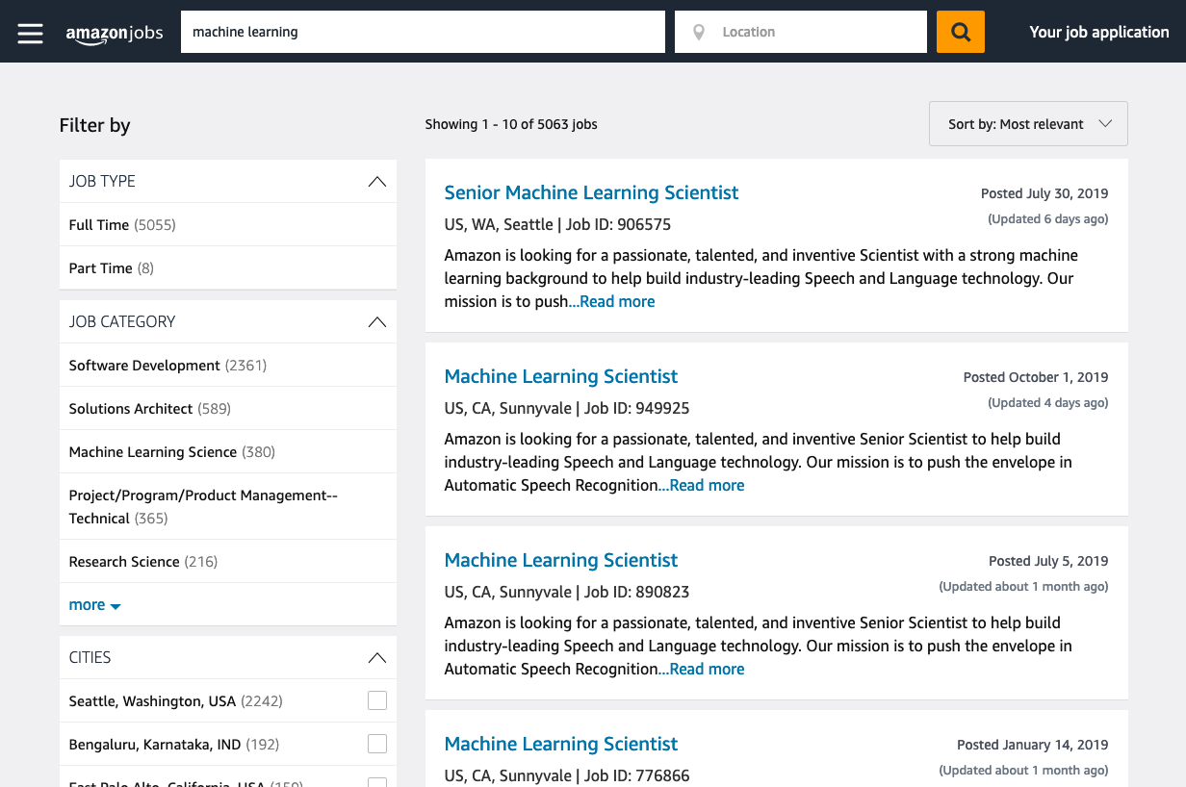
We are Hiring!
https://amazon.jobs

